Slide 1

UNIVERSITY INSTITUTE OF ENGINEERING
DEPARTMENT OF COMPUTER SCIENCE AND ENGG.
Bachelor of Engineering (Computer Science & Engineering)
DATA STRUCTURES
TREES
DISCOVER . LEARN . EMPOWER

Slide 2

TREES IN DATA STRUCTURE

Slide 3
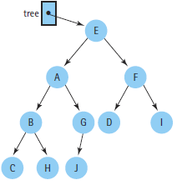
Tree
Collection of nodes or
Finite set of nodes
This collection can be empty
Nodes and Edges
Root
Parent, Child, Siblings, Grand parent, Grand child, Ancestors, Decendents
Every node except the root has one parent
Subtree
Degree of a node is # of its sub trees

Slide 4
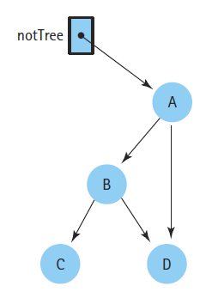
Tree

Slide 5
Why Trees?
1. One reason to use trees might be because you want to store information that naturally forms a hierarchy. For example, the file system on a computer:
2. Trees (with some ordering e.g., BST) provide moderate access/search (quicker than Linked List and slower than arrays).
3. Trees provide moderate insertion/deletion (quicker than Arrays and slower than Unordered Linked Lists).
4. Like Linked Lists and unlike Arrays, Trees don’t have an upper limit on number of nodes as nodes are linked using pointers.

Slide 6
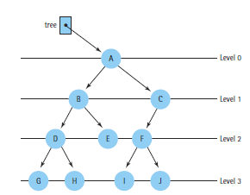
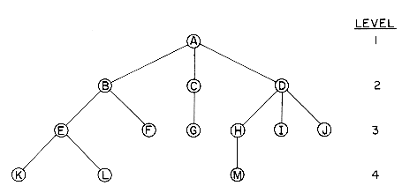
Tree levels
Two different approaches

Slide 7
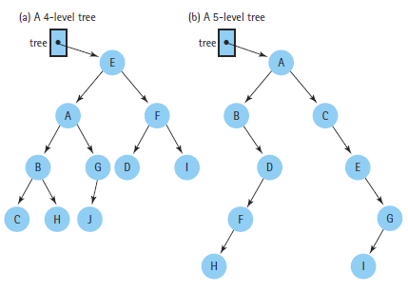
Tree levels

Slide 8
Tree
A path from node n₁ to n_{k} is defined as a sequence of nodes n₁, n₂, …….., n_{k}
The length of this path is the number of edges on the path
There is a path of length zero from every node to itself
There is exactly one path from the root to each node in a tree

Slide 9
Tree
Height of a node is the length of a longest path from this node to a leaf
All leaves are at height zero
Height of a tree is the height of its root (maximum level)

Slide 10
Tree
Depth of a node is the length of path from root to this node
Root is at depth zero
Depth of a tree is the depth of its deepest leaf that is equal to the height of this tree

Slide 11
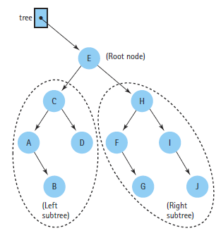
Binary Trees
There is no node with degree greater than two

Slide 12
Terminology
node: the item of information plus the branches to each node.
degree: the number of subtrees of a node
degree of a tree: the maximum of the degree of the nodes in the tree.
terminal nodes (or leaf): nodes that have degree zero
nonterminal nodes: nodes that don’t belong to terminal nodes.
children: the roots of the subtrees of a node X are the children of X
parent: X is the parent of its children.

Slide 13
Some Terminology (cont’d)
Siblings: children of the same parent are said to be siblings.
Ancestors of a node: all the nodes along the path from the root to that node.
The level of a node: defined by letting the root be at level one. If a node is at level l, then it children are at level l+1.
Height (or depth): the maximum level of any node in the tree

Slide 14
Example
A is the root node
B is the parent of D and E
C is the sibling of B
D and E are the children of B
D, E, F, G, I are external nodes, or leaves
A, B, C, H are internal nodes
The level of E is 3
The height (depth) of the tree is 4
The degree of node B is 2
The degree of the tree is 3
The ancestors of node I is A, C, H
The descendants of node C is F, G, H, I
Property: (# edges) = (#nodes) - 1
Level
A
1
B
C
2
H
3
D
E
F
G
I
4

Slide 15
Binary Tree
Binary tree
Not a binary tree

Slide 16
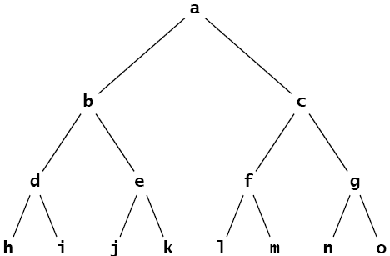
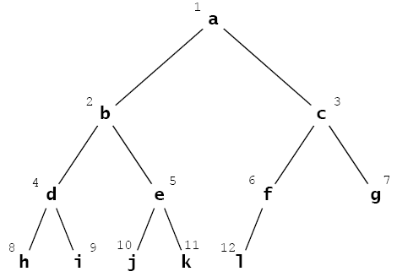
Binary Tree
Full binary tree
Complete binary tree

Slide 17
Full Binary Tree
A binary tree is said to be full if all its leaves are at the same level and every internal node has two
children.
The full binary tree of height h has
l = 2^{h} leaves
and
m = 2^{h} – 1 internal nodes.
Total # of Nodes?
Find height of tree if # of nodes are given

Slide 18
Complete Binary Tree
A complete binary tree is either a full binary tree or one that is full except for a segment of missing leaves on the right side of the bottom level.

Slide 19
Tree Traversals
Pre-Order
N L R
In-Order
L N R
Post-Order
L R N

Slide 20
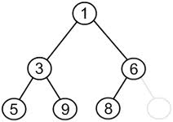
Tree Traversals Pre-Order(NLR)
1, 3, 5, 9, 6, 8

Slide 21
Tree Traversals In-Order(LNR)
5, 3, 9, 1, 8, 6

Slide 22
Tree Traversals Post-Order(LRN)
5, 9, 3, 8, 6, 1

Slide 23
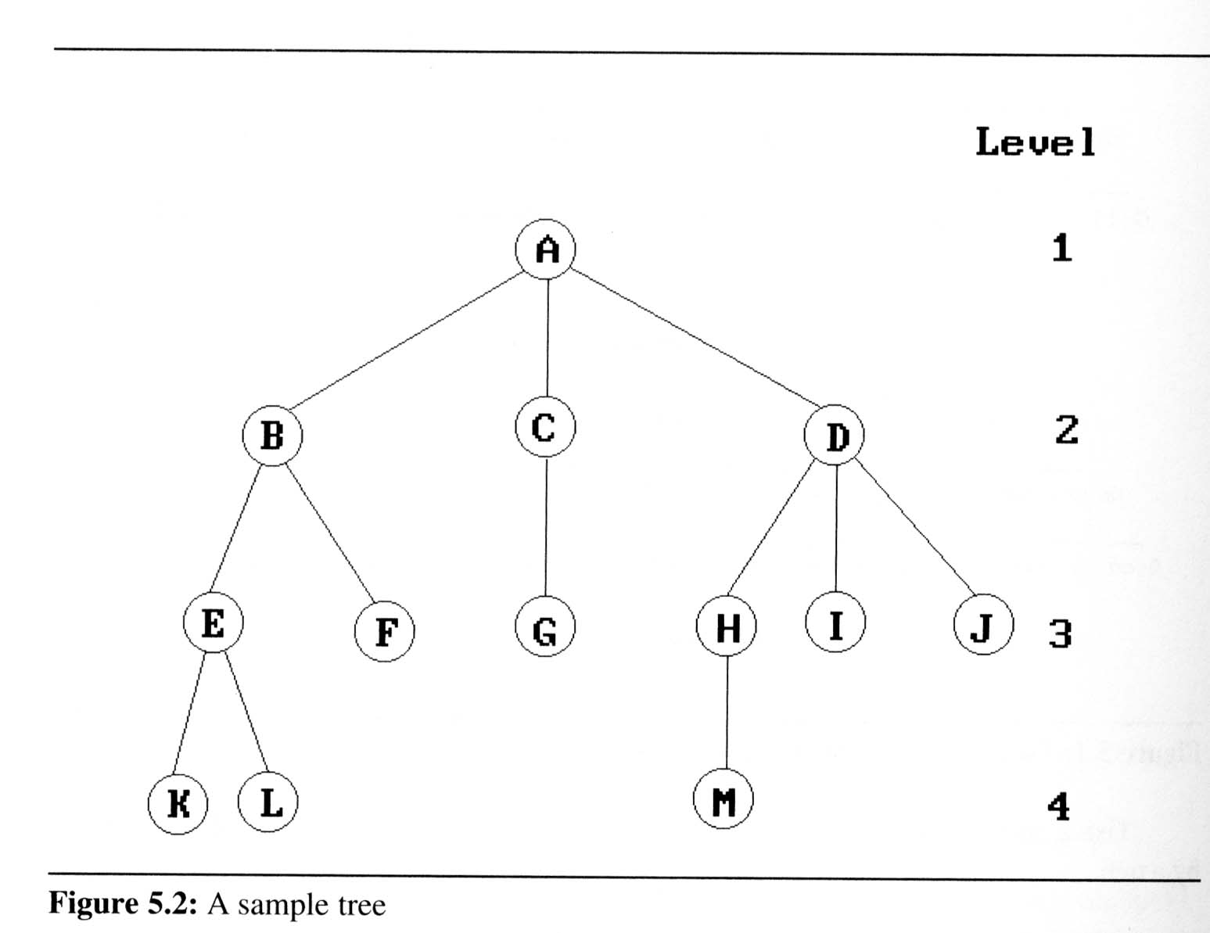
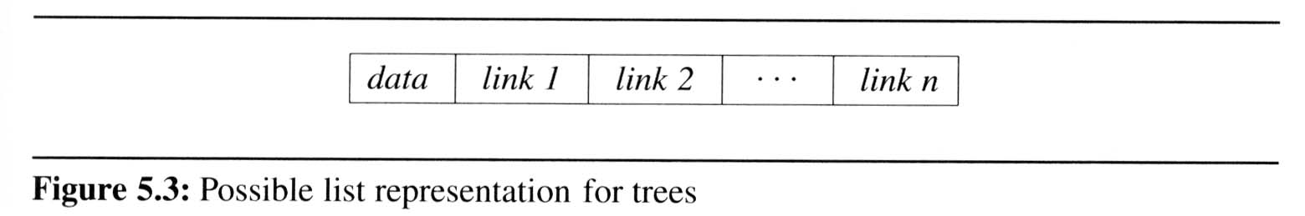
List Representation
we can write of Figure 5.2 as a list in which each of the subtrees is also a list
( A ( B ( E ( K, L ), F ), C ( G ), D ( H ( M ), I, J ) ) )
The root comes first, followed by a list of sub-trees

Slide 24
Representation of Trees
[1]
[2]
[3]
[4]
[5]
[6]
[7]
[8]
[9]
A
B
C
D
E
F
G
H
I
(1) waste space
(2) insertion/deletion
problem
A
[1]
[2]
[3]
[4]
[5]
[6]
[7]
[8]
[9]
.
[16]
A
B
--
C
--
--
--
D
--
.
E
B
A
C
B
C
D
D
E
F
G
E
H
I

Slide 25
Linked Representation
typedef struct node *tree_pointer;
typedef struct node {
int data;
tree_pointer left_child, right_child;
};
data
left_child
data
right_child
left_child
right_child

Slide 26
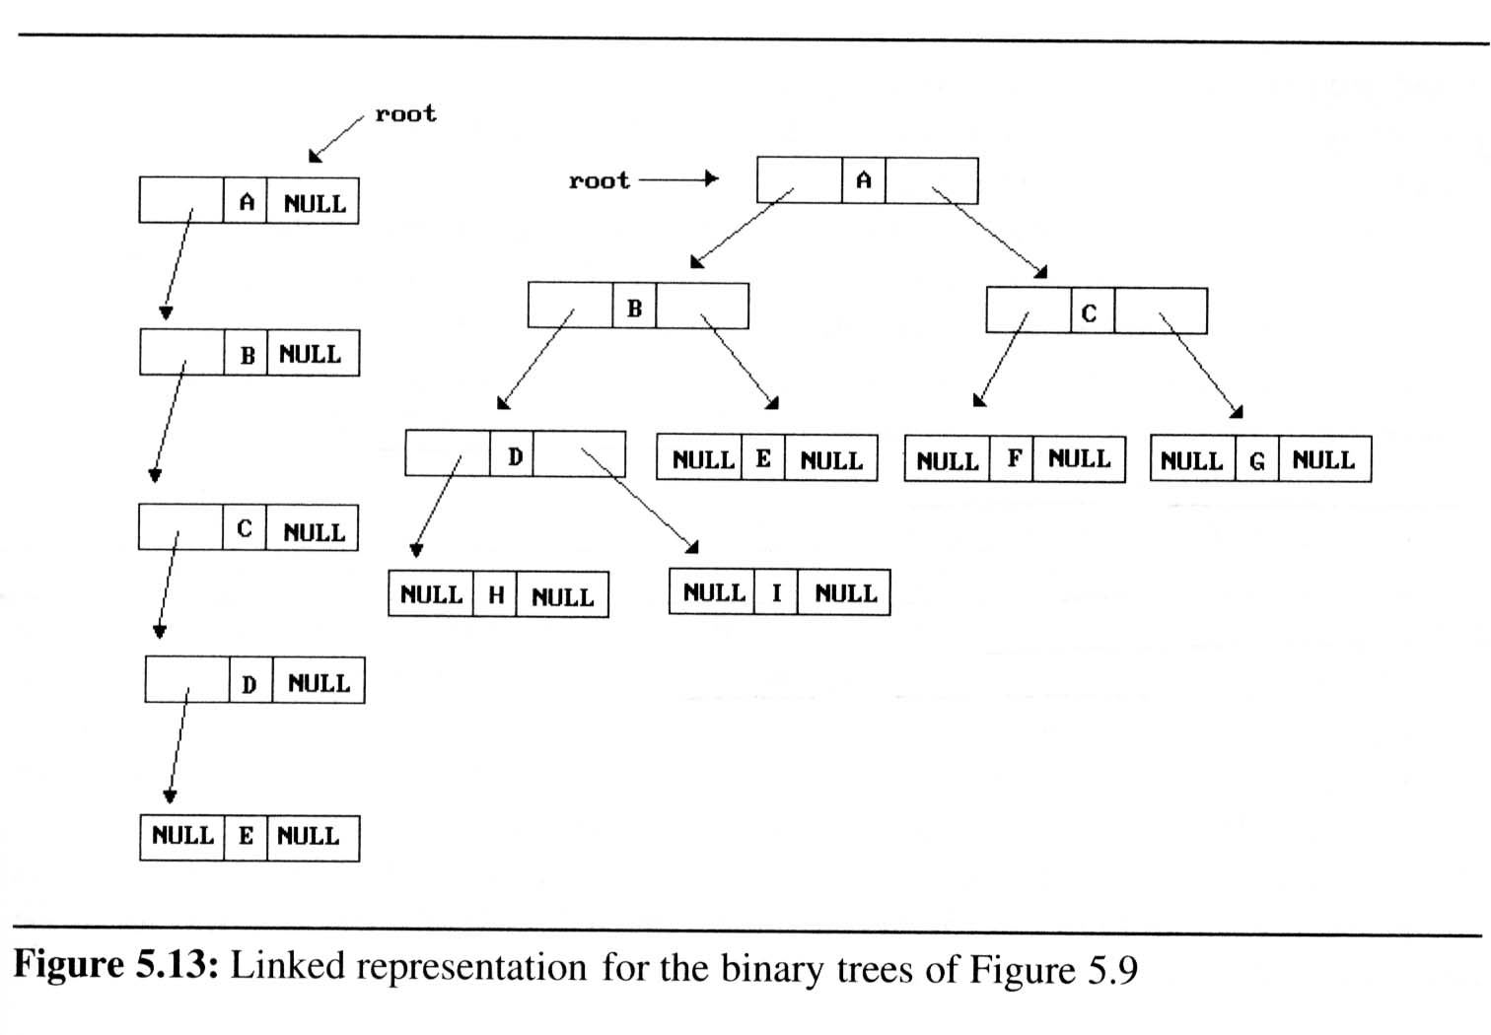
Cont’d

Slide 27
Properties of Binary Trees
Properties of binary trees
Lemma 5.1 [Maximum number of nodes]:
The maximum number of nodes on level i of a binary tree is 2^{i-1}, i ≥1.
The maximum number of nodes in a binary tree of depth k is 2^{k}-1, k≥1.
Lemma 5.2 [Relation between number of leaf nodes and degree-2 nodes]:
For any nonempty binary tree, T, if n₀ is the number of leaf nodes and n₂ is the number of nodes of degree 2, then n₀ = n₂ + 1.
These lemmas allow us to define full and complete binary trees

Slide 28
Preoder, Inorder, Postorder
In Preorder, the root
is visited before (pre)
the subtrees traversals
In Inorder, the root is
visited in-between left
and right subtree traversal
In Preorder, the root
is visited after (pre)
the subtrees traversals
Preorder Traversal:
Visit the root
Traverse left subtree
Traverse right subtree
Inorder Traversal:
Traverse left subtree
Visit the root
Traverse right subtree
Postorder Traversal:
Traverse left subtree
Traverse right subtree
Visit the root

Slide 29
Illustrations for Traversals
Assume: visiting a node
is printing its label
Preorder:
1 3 5 4 6 7 8 9 10 11 12
Inorder:
4 5 6 3 1 8 7 9 11 10 12
Postorder:
4 6 5 3 8 11 12 10 9 7 1
1
3
7
5
8
9
10
4
6
11
12

Slide 30
Illustrations for Traversals (Contd.)
Assume: visiting a node
is printing its data
Preorder: 15 8 2 6 3 7
11 10 12 14 20 27 22 30
Inorder: 2 3 6 7 8 10 11
12 14 15 20 22 27 30
Postorder: 3 7 6 2 10 14
12 11 8 22 30 27 20 15
15
8
20
2
11
27
6
10
12
22
30
3
7
14

Slide 31
Code for the Traversal Techniques
The code for visit
is up to you to
provide, depending
on the application
A typical example
for visit(…) is to
print out the data
part of its input
node
void preOrder(Tree *tree){
if (tree->isEmpty( )) return;
visit(tree->getRoot( ));
preOrder(tree->getLeftSubtree());
preOrder(tree->getRightSubtree());
}
void inOrder(Tree *tree){
if (tree->isEmpty( )) return;
inOrder(tree->getLeftSubtree( ));
visit(tree->getRoot( ));
inOrder(tree->getRightSubtree( ));
}
void postOrder(Tree *tree){
if (tree->isEmpty( )) return;
postOrder(tree->getLeftSubtree( ));
postOrder(tree->getRightSubtree( ));
visit(tree->getRoot( ));
}

Slide 32
Application of Traversal Sorting a BST
Observe the output of the inorder traversal of the BST example two slides earlier
It is sorted
This is no coincidence
As a general rule, if you output the keys (data) of the nodes of a BST using inorder traversal, the data comes out sorted in increasing order

Slide 33
Other Kinds of Binary Trees (Full Binary Trees)
Full Binary Tree: A full binary tree is a binary tree where all the leaves are on the same level and every non-leaf has two children
The first four full binary trees are:

Slide 34
Examples of Non-Full Binary Trees
These trees are NOT full binary trees: (do you know why?)

Slide 35
Canonical Labeling of Full Binary Trees
Label the nodes from 1 to n from the top to the bottom, left to right
1
1
1
3
2
2
3
4
5
6
7
1
2
3
Relationships between labels
of children and parent:
5
6
7
4
i
8
9
10
11
13
14
15
2i
2i+1
12

Slide 36
Other Kinds of Binary Trees (Almost Complete Binary trees)
Almost Complete Binary Tree: An almost complete binary tree of n nodes, for any arbitrary nonnegative integer n, is the binary tree made up of the first n nodes of a canonically labeled full binary
1
1
1
1
1
2
3
2
2
3
2
1
1
4
5
6
4
2
3
2
3
4
5
4
5
6
7

Slide 37
References
Li`pschutz, Seymour, “Data Structures”, Schaum's Outline Series, Tata McGraw Hill.
Data structure and algorithm by Narasimha Karumanchi.
www.tutorialspoint.com
www.geeksforgeeks.com
37

Slide 38
Books Recommended
Goodrich, Michael T., Tamassia, Roberto, and Mount, David M., “Data Structures and Algorithms in C++”, Wiley Student Edition.
Aho, Alfred V., Ullman, Jeffrey D., Hopcroft ,John E. “Data Structures and Algorithms”, Addison Wesley
Lipschutz, Seymour, “Data Structures”, Schaum's Outline Series, Tata McGraw Hill.
Gilberg/Forouzan,” Data Structure with C ,Cengage Learning.
Augenstein,Moshe J , Tanenbaum, Aaron M, “Data Structures using C and C++”, Prentice Hall of India

Slide 39
THANK YOU

